Slide 1
Dataset is available at: https://www.kaggle.com/datasets/karangadiya/fifa19
Project goal: We are going to predict the footballer’s ideal playing position based on the footballer’s key skills,
FIFA ratings, strengths, weaknesses, physicality, & historical statistics.
Project Objectives:
● Preliminary analysis to understand our data
● Exploratory data analysis, to understand the correlations between features, followed by data cleaning
● Feature engineering to pick the correct features for our model
● Build appropriate machine learning models
● Comparing the accuracy of all the models and choosing the best model to predict the player positions
Introduction

Slide 2
Data Cleaning
fifa.info()
We have 12.4 MB's dataset. It includes three kind of datatypes: float, int and object.
print('Number of Categorical Columns: ', len(fifa.select_dtypes(include=object).columns))
print('Number of Numerical Columns: ', len(fifa.select_dtypes(exclude=object).columns))
Number of Categorical Columns: 45
Number of Numerical Columns: 44
fifa.nunique()
fifa.isnull().any()

Slide 3
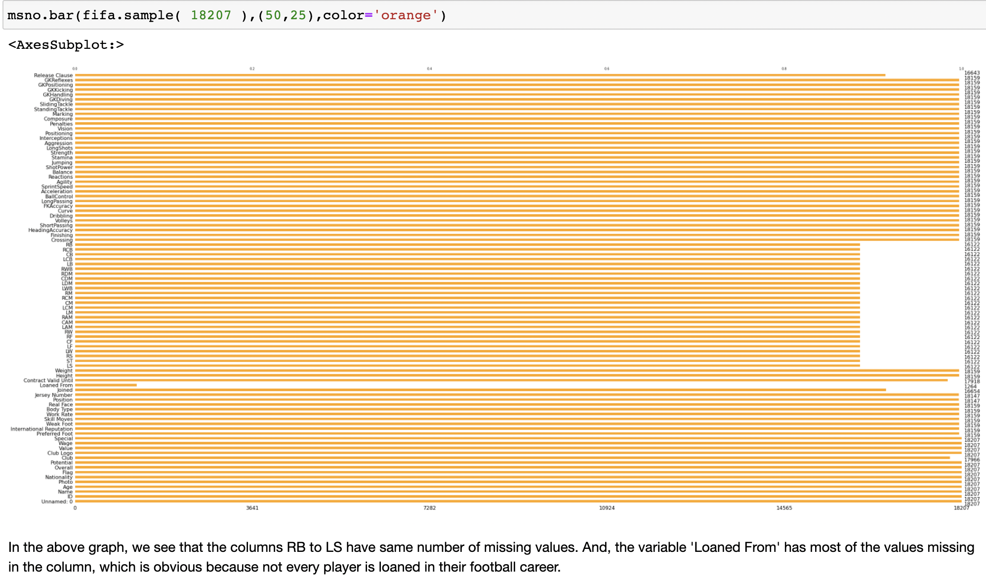

Slide 4
Checking for nulls and dropping it
fifa.isnull().sum() - Getting the total number of nulls
missing_1 = fifa[fifa['GKHandling'].isnull()].index.tolist()
missing_2 = fifa[fifa['GKReflexes'].isnull()].index.tolist()
if missing_1 == missing_2:
print('They are same')
else:
print('They are different')
They are same
As they are same we can confidently assume that it will be same for other all columns too.
fifa.drop(fifa.index[missing_1],inplace =True)
fifa.isnull().sum()
Here we further get nulls as 0 and we have therefore eliminated the nulls successfully.

Slide 5
Converting Categorical to appropriate numerical values
Best player in different aspects
Function to convert value and wage of the player
Converting height to cms, & converting weight to lbs
Converting the rating at each position to int

Slide 6
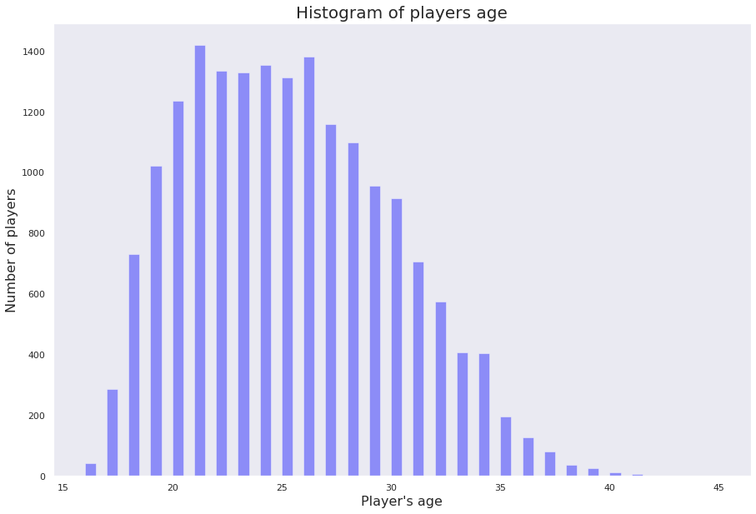
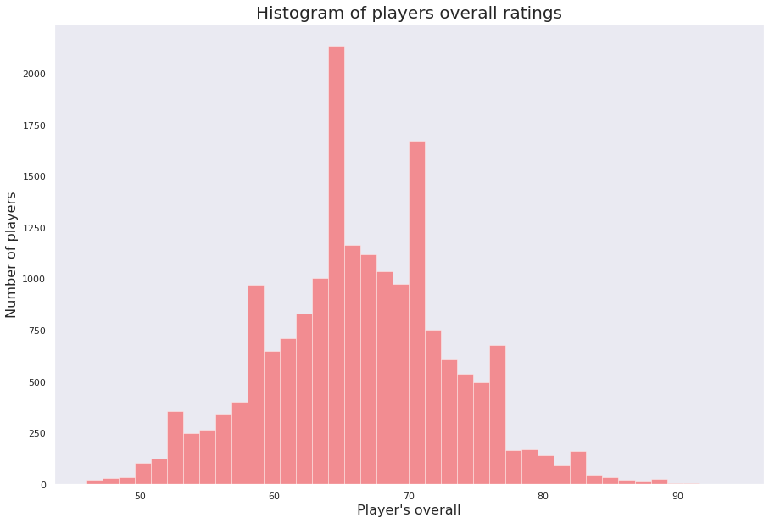
EDA & Visualization
First we plotted histograms on various attributes to understand the distribution of the data:

Slide 7
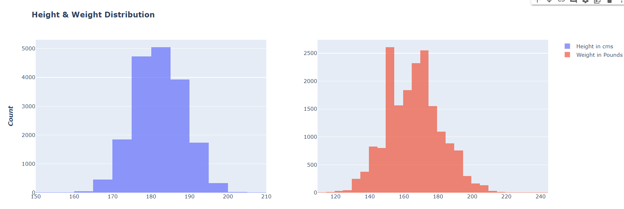
Height & Weight distribution

Slide 8
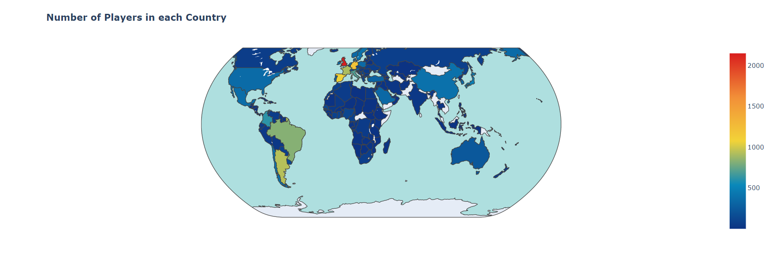
Player distribution across countries

Slide 9
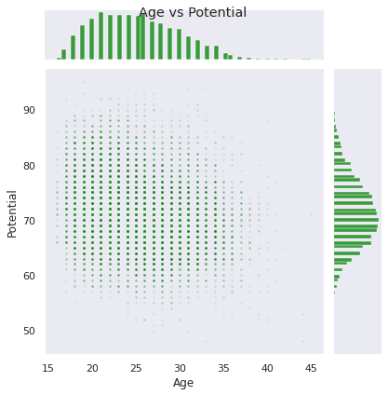
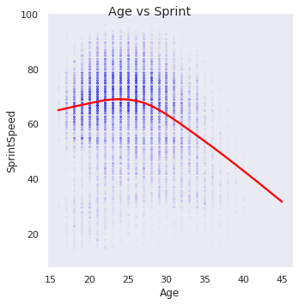
Correlation between attributes

Slide 10
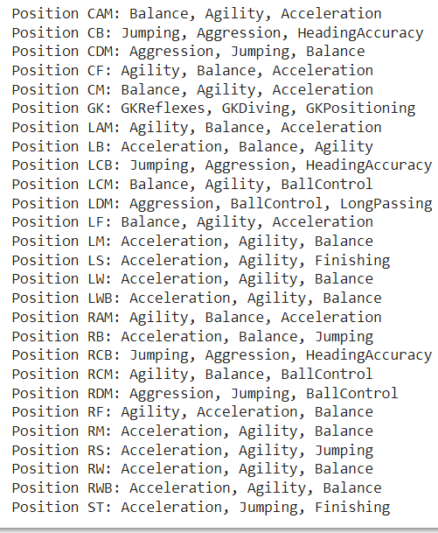
Top Features according to position

Slide 11
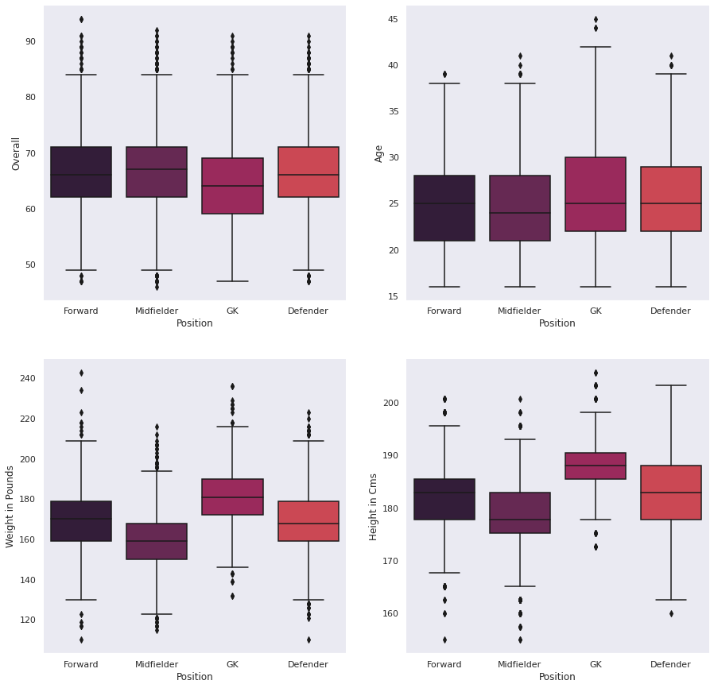
Visualization after grouping position into 4 categories.

Slide 12
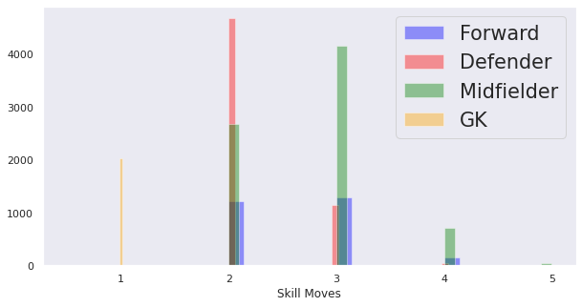
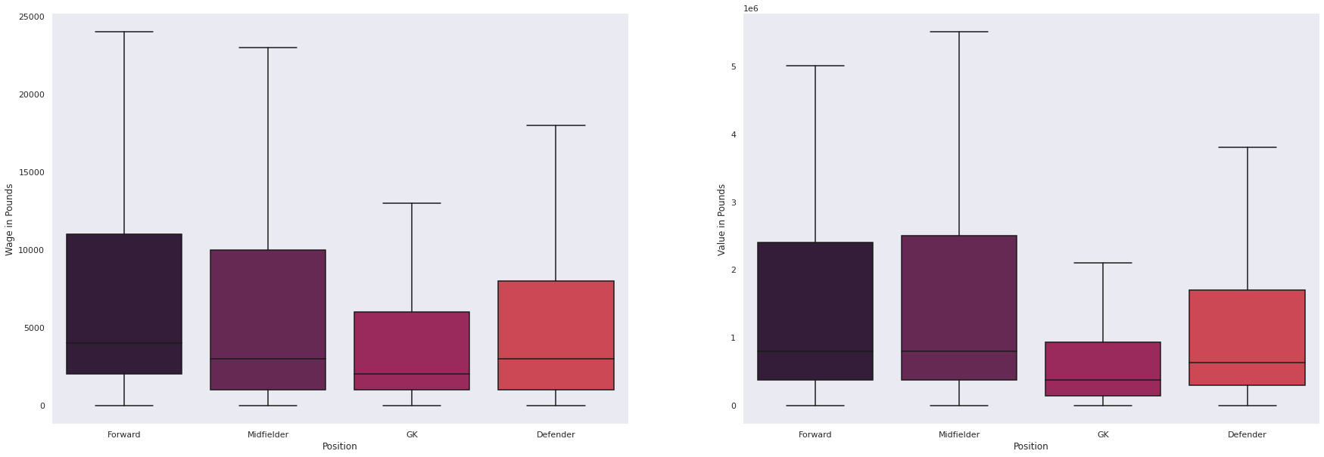
Visualization after grouping position into 4 categories

Slide 13
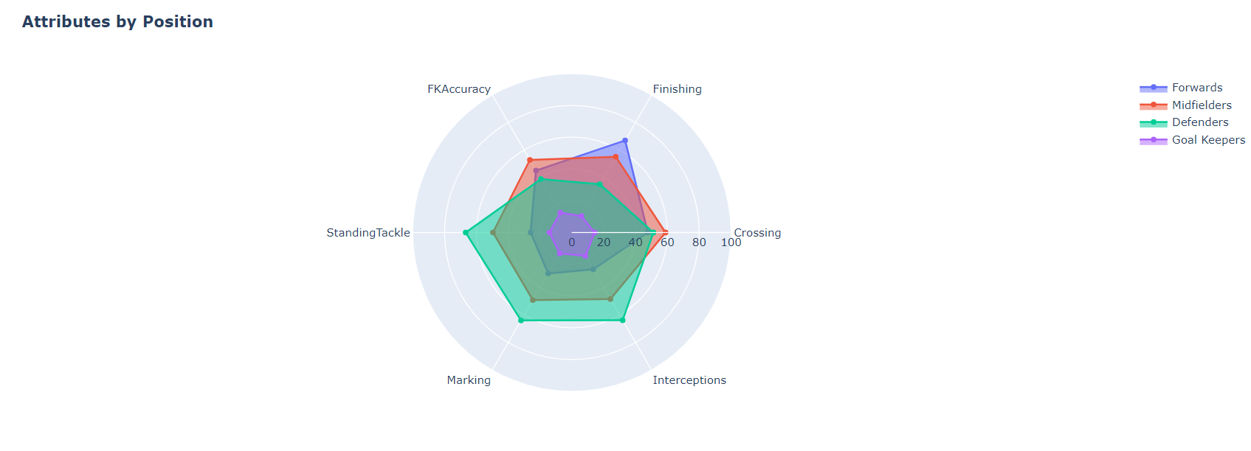

Slide 14
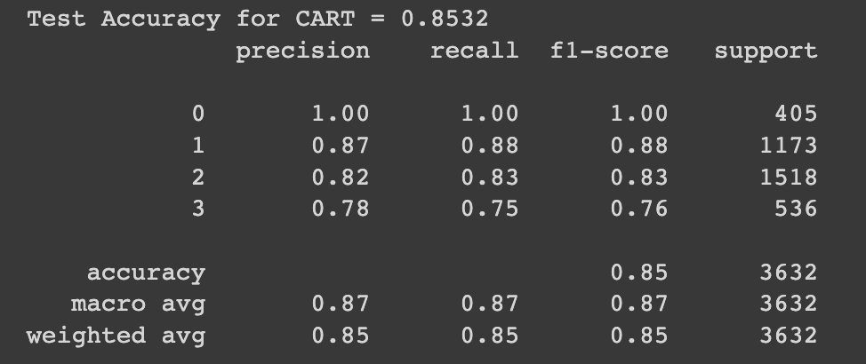
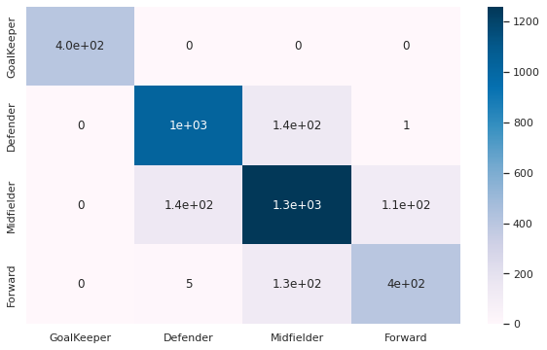
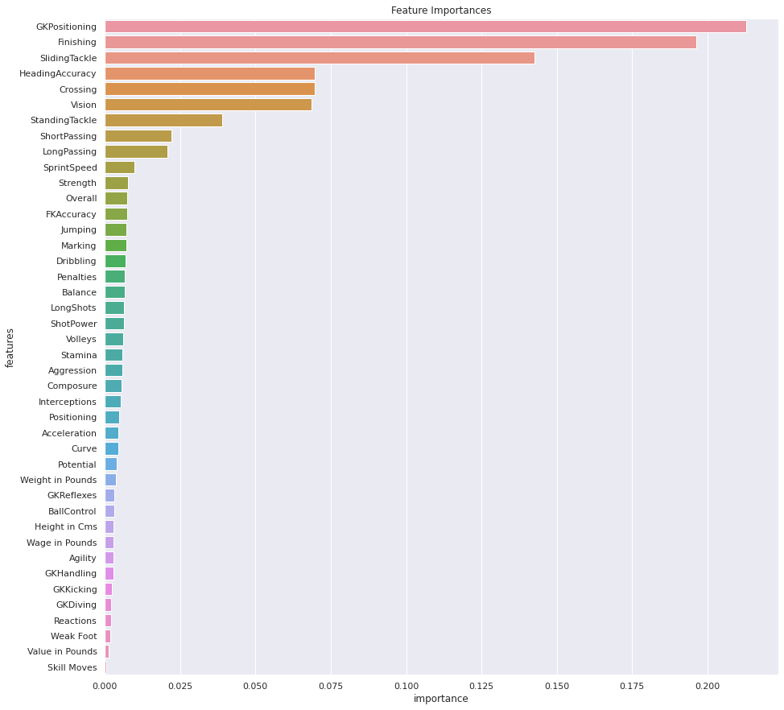
CART

Slide 15
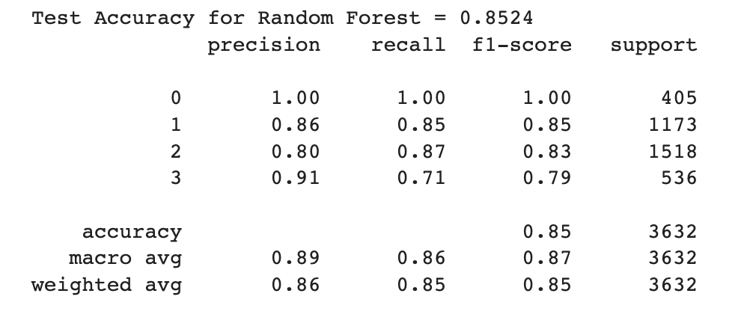

Random Forest - Done with Hyperparameter tuning

Slide 16
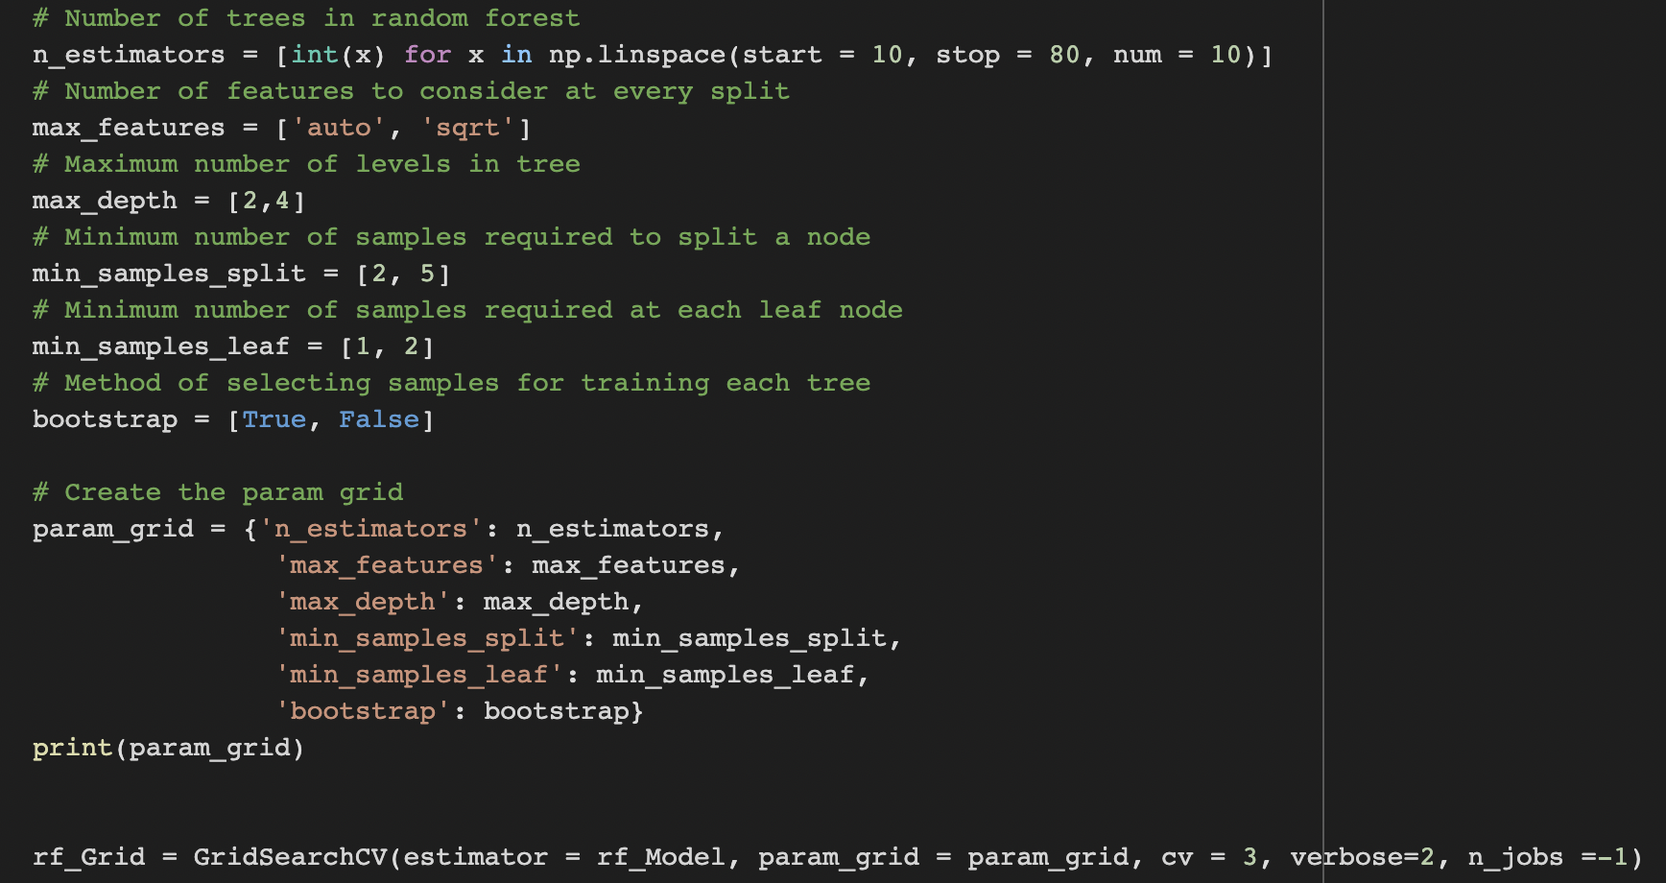
Random Forest - Hyperparameter Tuning

Slide 17
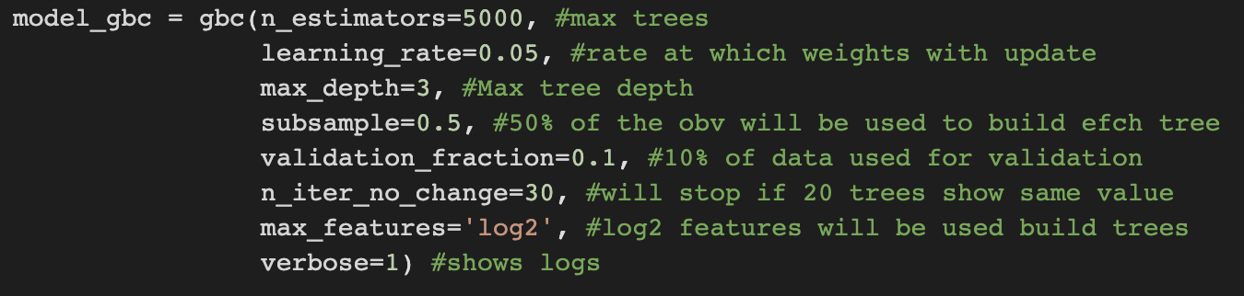
Gradient Boosting Classifier

Slide 18
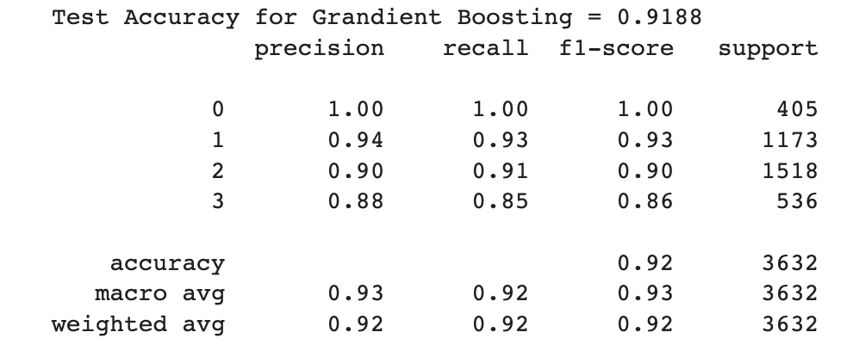
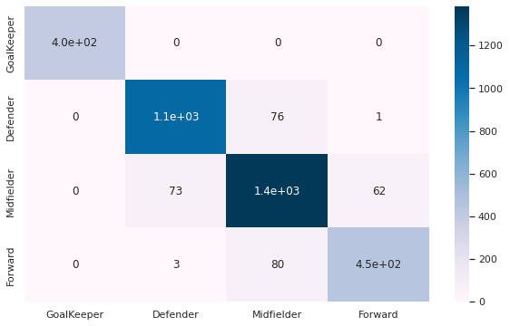
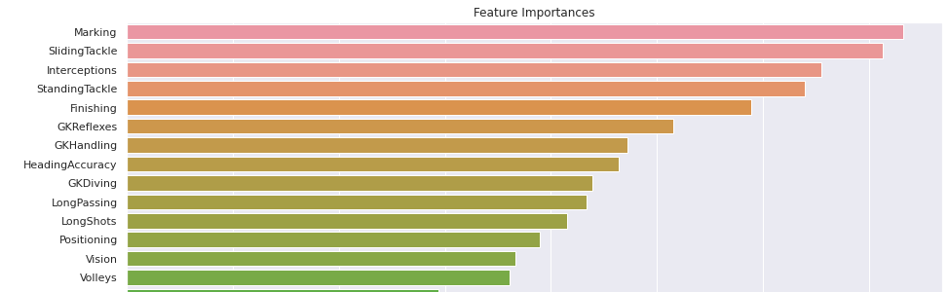
Gradient Boosting Classifier

Slide 19
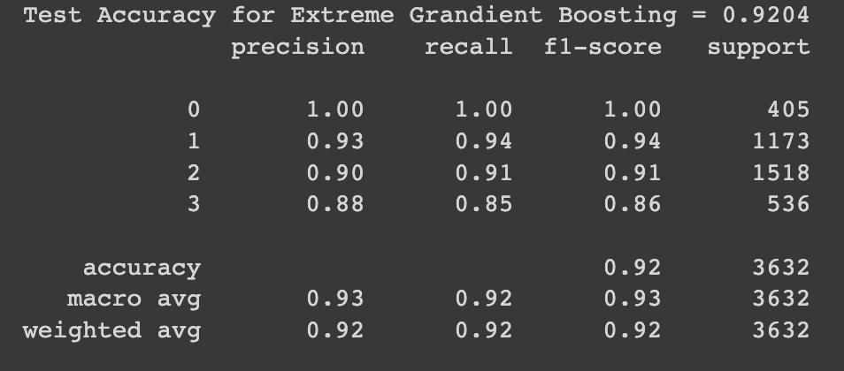

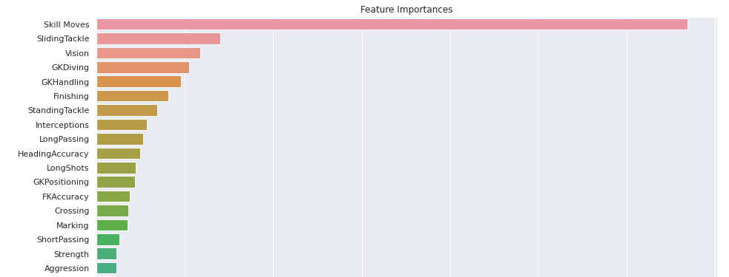
Xtreme Gradient Boosting- Done with Hyperparameter tuning

Slide 20
Conclusion
Xtreme Gradient Boosting gave us the best overall accuracy, precision, recall and F1 scores.
Key learnings through this project:
Apt data cleaning & EDA gives clarity
Choosing the right ML model
Ensuring the right number of classes in a multiclass classification
Overcoming the curse of dimensionality

Slide 21
Thank you!

Slide 22
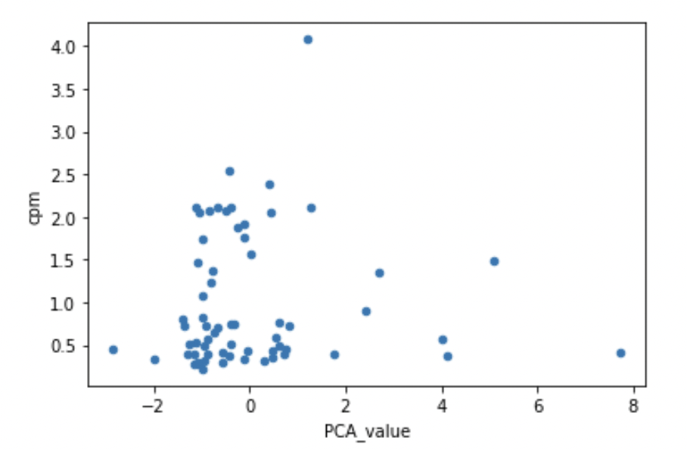
Don’t Target
Target

